Slide 1

ITC6355 70925 Web App Design & Development
FINAL PROJECT PRESENTATION
(PRESENTATION DATE: December 7, 2017)
SUBMITTED BY : THINKTANK TEAM
GUIDED BY : Mr. Aniruddhatreya Rajagopalan

Slide 2
GOTin – Online Job Search Portal
Job Search - User
User signup
Login
Job search
Job Apply
Employer - User
User signup
Login
Job Post

Slide 3
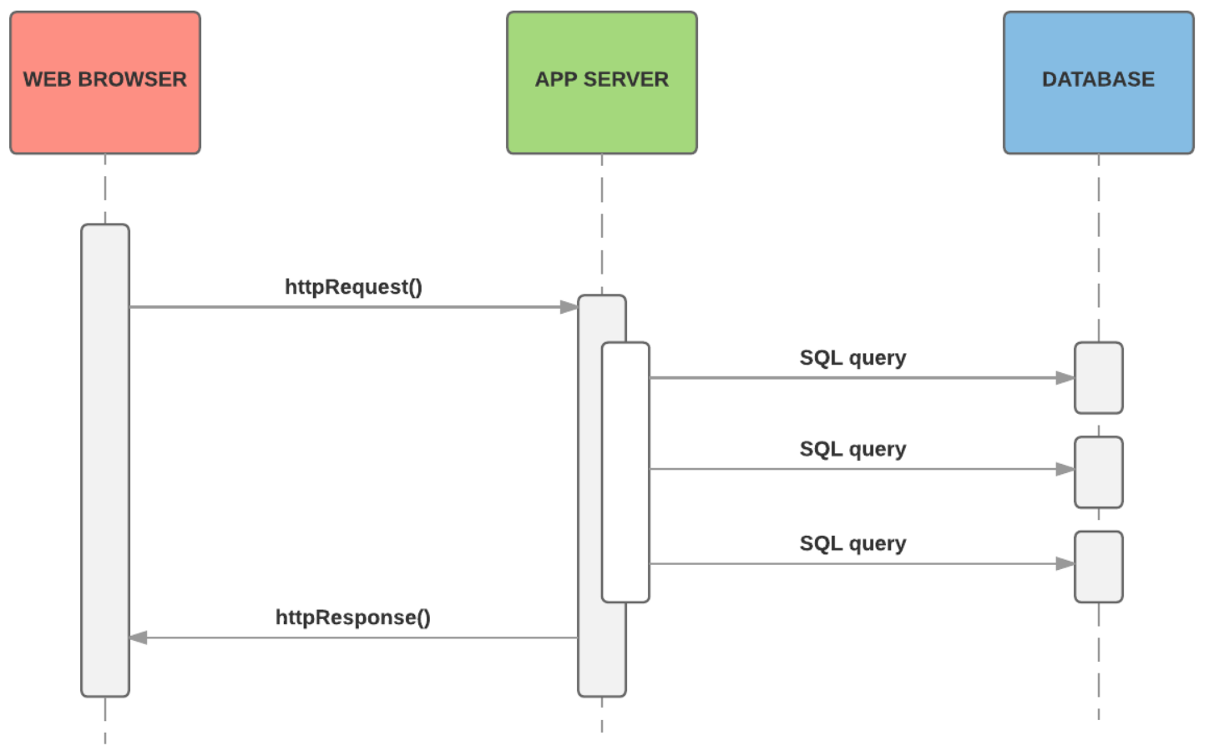
Technologies Used
Front End
HTML
CSS
JavaScript(jQuery, ladda)
Bootstrap
Backend
.NET MVC 4(C#)
Database
SQL server

Slide 4
HTML Architecture
<head>
head
</head>
Linked All CSS files
Main JS files
@Html.Partial("_header")
Layout.html
<body>
header
subbody
Footer
</body>
@RenderBody
@Html.Partial("_footer")- Linked remaining js files

Slide 5
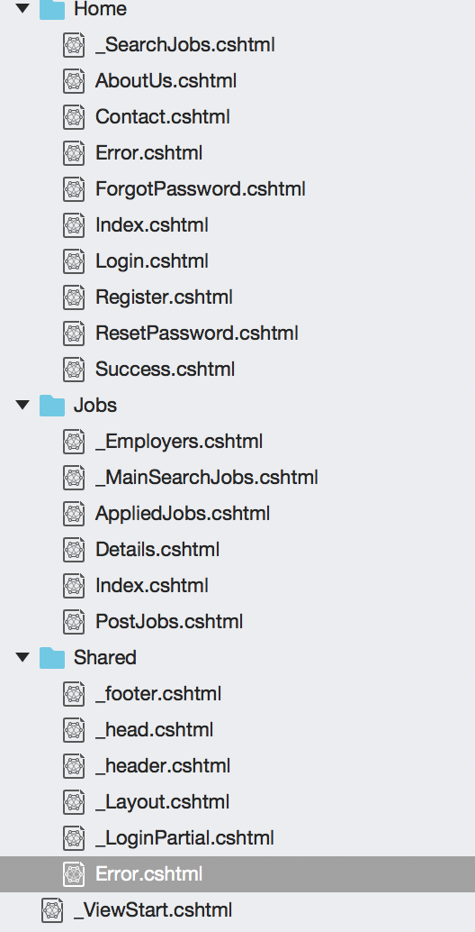
JavaScript – Front End of GOTIN
Totally there are three divisions in the view.
Home – which will have all the basic html pages ( Login, Register, ResetPassword, Forgot password, success etc.)
Jobs – It will have all the job related Html (Employers, Mainsearch Job, Details, Post Jobs etc.)
Shared –It will have shared HTML pages (Header, Footer, Layout, etc)

Slide 6
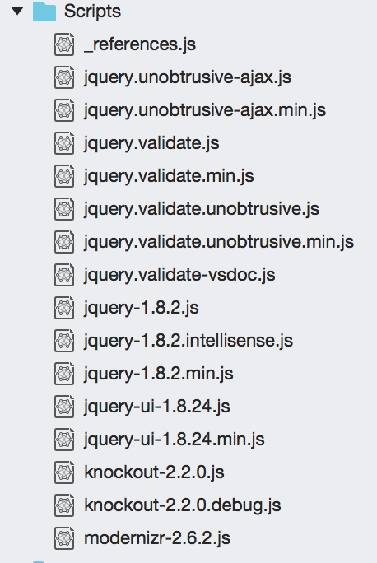
JavaScript – Front End of GOTIN
view Pages mentioned in the previous slide, we have written client Side Scripting and did most of the CSS work.
Included the frameworks like Bootstrap, jQuery and important JavaScript frameworks.
Performed AJAX – Made GOTIN asynchrounous
Some of the scripts have been added in their respective HTML pages.

Slide 19
MVC of GOTin

Slide 20
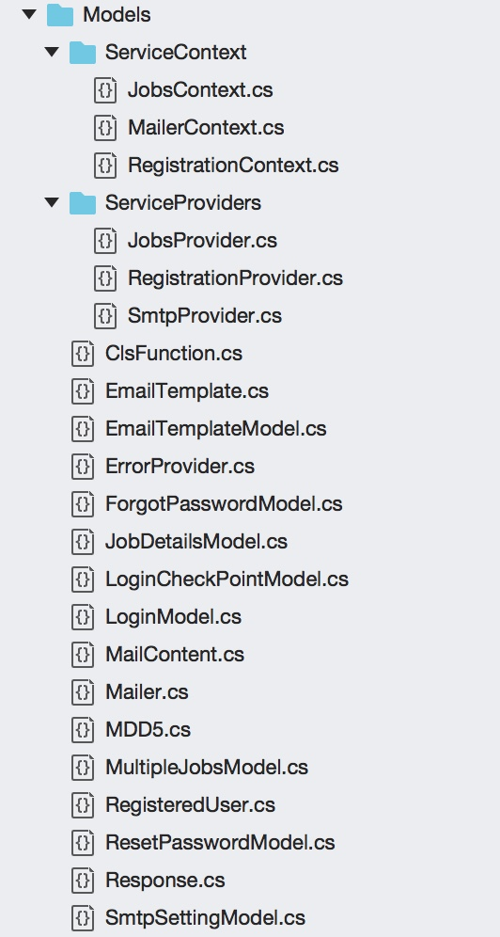
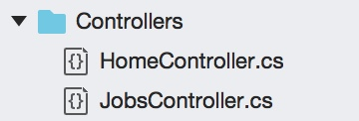
Project Specific MVC filles

Slide 21
Database Schemas

Slide 22
References
NA(December,2017) Indeed online job portal Retrieved from https://www.indeed.com/
NA(December,2017) Monster Jobs Retrieved from https://www.monster.com/
NA(December,2017) NU Careers Retrieved from https://nucareers.northeastern.edu/notLoggedIn.htm
Using of Jquery Retrieved from http://purencool.com/javascript-and-jquery-what-is-the-difference
Learnin Bootstrap Retrieved from https://www.w3schools.com/bootstrap/bootstrap_get_started.asp
jQuery tutorials Retrieved from https://www.digitalocean.com/community/tutorials/an-introduction-to-jquery
Box model of CSS Retrieved from https://www.w3schools.com/css/css_boxmodel.asp
MVC Architecture Retrieved from http://www.tutorialsteacher.com/mvc/mvc-architecture
ASP .NET MVC 4 official documnetation Retrieved from https://docs.microsoft.com/en-us/aspnet/mvc/mvc4

